Slide 1



Attrition Dashboard
View in Power BI
Last data refresh:
5/15/2023 8:39:27 PM UTC
Downloaded at:
5/15/2023 8:58:35 PM UTC

Slide 2
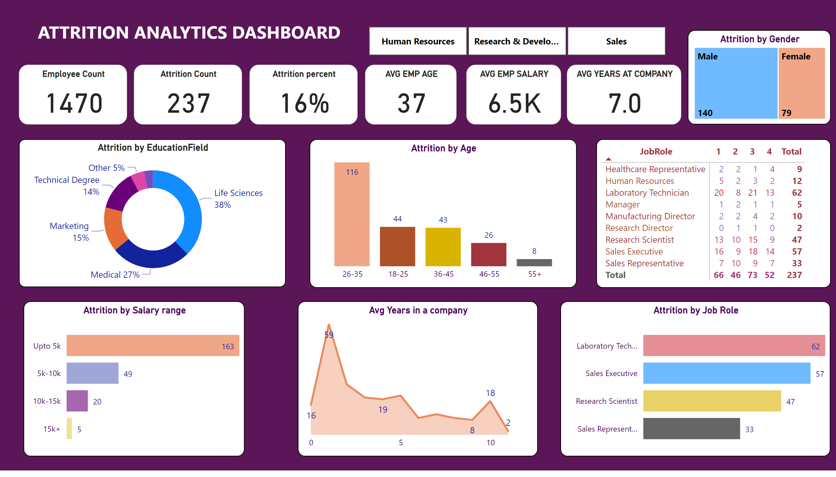
Page 1
Notes:
Employee Count
No alt text provided
Attrition Count
No alt text provided
Attrition percent
No alt text provided
AVG EMP AGE
No alt text provided
AVG EMP SALARY
No alt text provided
AVG YEARS AT COMPANY
No alt text provided
Attrition by EducationField
No alt text provided
Attrition by Age
No alt text provided
pivotTable
No alt text provided
Attrition by Salary range
No alt text provided
Attrition by Job Role
No alt text provided
Avg Years in a company
No alt text provided
Attrition by Gender
No alt text provided
slicer
No alt text provided
textbox
No alt text provided

